Slide 1


Developing cross-platform plug-ins with .NET Standard
Marco Minerva
@marcominerva
Microsoft MVP Windows Development

Slide 2
#CodeGen

Slide 3

Main sponsor

Slide 4






Community sponsors

Slide 5


Local Event

Slide 6
We have to develop an application that runs on multiple platforms

Slide 7
.NET «classic»
.NET FRAMEWORK
.NET CORE
XAMARIN
APP
MODELS
WPF
Windows Forms
UWP
iOS
Android
ASP.NET
ASP.NET Core
OS X
BASE
LIBRARIES
.NET Framework BCL
.NET Core BCL
Mono BCL
Notes:
Notes: Even if we are reusing a lot across components (especially with the open sourcing last year), the reality is that each platform has its own implementation of the base libraries.
Note: .NET Framework BCL and Mono BCL are the same APIs, different implementation. .NET Core “Core Library” is a similar set of APIs, but different.

Slide 8
.NET classic – reusing code
.NET FRAMEWORK
.NET CORE
XAMARIN
CHALLENGES
Difficult to reuse skills
Need to master 3+1 base class libraries
Difficult to reuse code
Need to target a fairly small common denominator
Difficult to innovate
Need implementations on each platform
APP
MODELS
WPF
Windows Forms
UWP
iOS
Android
ASP.NET
ASP.NET Core
OS X
BASE
LIBRARIES
.NET Framework BCL
.NET Core BCL
Mono BCL
Notes:
Notes: Even if we are reusing a lot across components (especially with the open sourcing last year), the reality is that each platform has its own implementation of the base libraries.
Note: .NET Framework BCL and Mono BCL are the same APIs, different implementation. .NET Core “Core Library” is a similar set of APIs, but different.

Slide 9
What is a Plug-in (in our scenario)?
A plug-in is a piece of code that implements a specific feature
Geolocation, Connectivity, Media, File system access, etc.
Features usually depend on platform and/or hardware capabilities
i.e., accessing geolocation on UWP is different than accessing it from Android or iOS (different APIs)
A plug-in is a way to abstract the differences and provide a unified access to these features

Slide 10
Portable Class Libraries (PCL)
PCLs were an after thought, i.e. each platform could decide which APIs to includes
No systematic approach to versioning
Computed intersection profiles
Each PCLs is targeting a specific set of platforms
Not compatible with newer platforms
Hard to understand compatibility relationships
Platform 1
Platform 3
Platform 2
Intersection Profiles

Slide 11
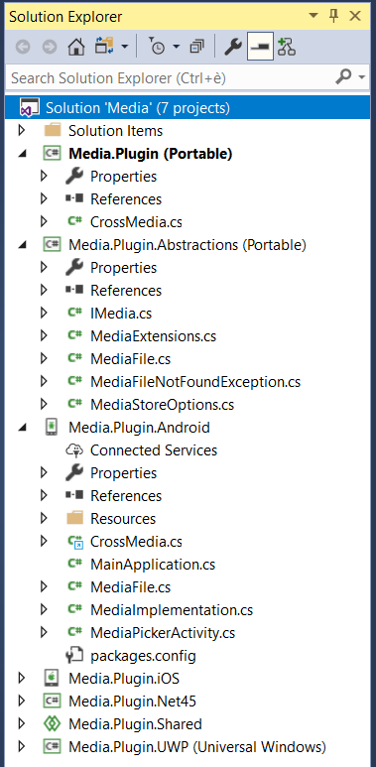
Plug-ins with Portable Class Libraries
One (or more) PCL projects
One project for each platform to support (targeting specific framework)
Hard to maintain

Slide 12
The new .NET World
.NET FRAMEWORK
.NET CORE
XAMARIN
APP
MODELS
WPF
Windows Forms
UWP
iOS
Android
ASP.NET
ASP.NET Core
OS X
BASE
LIBRARIES
.NET Standard
Notes:
Notes: Even if we are reusing a lot across components (especially with the open sourcing last year), the reality is that each platform has its own implementation of the base libraries.
Note: .NET Framework BCL and Mono BCL are the same APIs, different implementation. .NET Core “Core Library” is a similar set of APIs, but different.

Slide 13
The new .NET World
.NET FRAMEWORK
.NET CORE
XAMARIN
BENEFITS
Reuse skills
Master one BCL, not a Venn diagram
Reuse code
Common denominator is much bigger
Faster innovation
Target .NET Standard & run anywhere
APP
MODELS
WPF
Windows Forms
UWP
iOS
Android
ASP.NET
ASP.NET Core
OS X
BASE
LIBRARIES
.NET Standard
Notes:
Notes: Even if we are reusing a lot across components (especially with the open sourcing last year), the reality is that each platform has its own implementation of the base libraries.
Note: .NET Framework BCL and Mono BCL are the same APIs, different implementation. .NET Core “Core Library” is a similar set of APIs, but different.

Slide 14
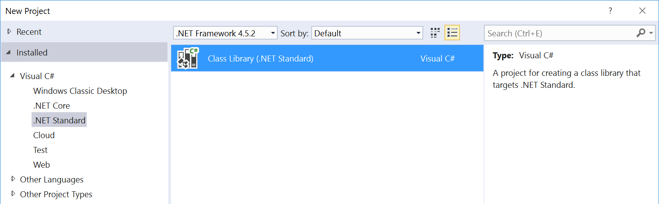
What is .NET Standard?
.NET Standard is a specification
A set of APIs that all .NET platforms have to implement
.NET Standard
.NET Framework
.NET Core
Xamarin
~
~
HTML specification
Browsers

Slide 15
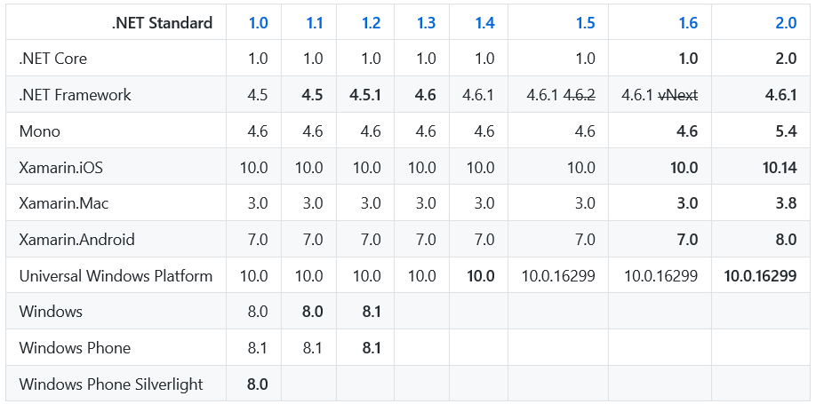
.NET Standard versions
Notes:
Che cosa significa compatibile? Significa ad esempio che in un’applicazone .NET Framework 4.6.1 possiamo utilizzare tutte le API definite nella versione 2.0 di .NET Standard.

Slide 16
Versioning in .NET Standard
Higher versions incorporate all APIs from previous versions.
Projects targeting version X.Y can reference libraries & projects targeting any version between 1.0 and X.Y
Concrete .NET platforms implement a specific version of .NET Standard
From that platform you can reference libraries up to that version
2.0
1.6
1.3
1.0

Slide 17
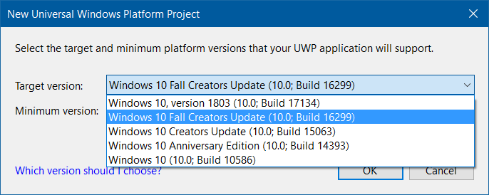
.NET Standard 2.0 on Universal Windows Platform
.NET Standard 2.0 is supported on UWP starting from the Fall Creators Update (16299)

Slide 18
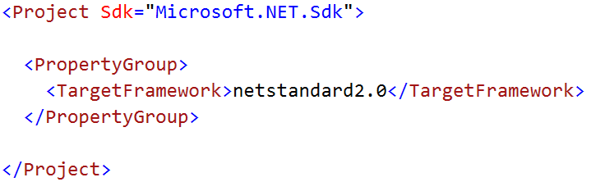
Multi-targeting with .NET Standard
.NET Standard uses a new csproj file format (SDK Style project)
A single .NET Standard Library can references multiple target frameworks
Targeting a specific .NET implementation is necessary to gain access to platform-specific APIs

Slide 19
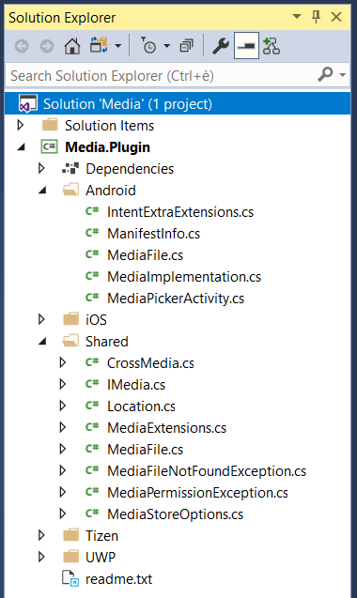
Plug-ins with .NET Standard and multi-targeting
A single project
Platform specific implementations automatically included in compilation output based on target platform
MSBuild.Sdk.Extras
Built-in support for creating NuGet packages

Slide 20
Demo

Slide 21
References
https://docs.microsoft.com/en-us/dotnet/standard/net-standard
https://marketplace.visualstudio.com/items?itemName=vs-publisher-473885.PluginForXamarinTemplates
https://github.com/onovotny/MSBuildSdkExtras
https://montemagno.com/multi-targeting-where-did-my-files-go-fixing-net-core-2-1-sdk-issues
https://github.com/NuGetPackageExplorer/NuGetPackageExplorer

Slide 22
https://github.com/marcominerva
@marcominerva
https://linkedin.com/in/marcominerva

